Slide 1
Why are Graph Neural Networks Effective for EDA
Haoxingr Ren, Siddarthan Nath, Yanqing Zhang, Hao Chen, Mingjie Liu
NVIDIA Corporation, University of Texas at Austin

Slide 2
Introduction
01
Background
02
Table of Contents
04
GNN for Design Optimization
GNN for Design Analysis
03
05
Challenge
06
Conclusion

Slide 3
01
Introduction

Slide 4
Graph Neural Network (GNN) is a deep learning model on graphs.
GNN was first proposed to deal with natural phenomenons.
VLSI data is deliberately generated, but get a surge of success in GNN domain.(why?)
Notes:
natural phenomenons: biochemical graphs(生物、化學的圖) .
要回答這個問題之前，我們必須要先知道一個東西。

Slide 5
◎ Physical Informed Machine Learning :
1. Introduce observational bias directly through data that embody the underlying physics.
2. Incorporate inductive biases corresponding to prior assumption by tailored interventions to an ML model architecture.
3. Introduce appropriate choice of loss function, constraints and inference algorithms as learning bias.
Notes:
基於物理信息的機器學習
Physical Informed Machine Learning將機器學習應用於model和預測多物理場和多尺度系統的動力學。例如，求解偏微分方程 (PDE)。
三個進行Physical Informed Machine Learning的主要原則。
從蒐集到的資料來獲取observation bias具體化它的內在物理機制
設定更具優先度的假設以及干預來制定inductive bias
選擇Loss function、constraints或是Inference algorithm等等來做為learning bias.

Slide 6
◎ Physical Informed Machine Learning :
1. Introduce observational bias directly through data that embody the underlying physics.
2. Incorporate inductive biases corresponding to prior assumption by tailored interventions to an ML model architecture.
3. Introduce appropriate choice of loss function, constraints and inference algorithms as learning bias.
Notes:
基於物理信息的機器學習
Physical Informed Machine Learning將機器學習應用於model和預測多物理場和多尺度系統的動力學。例如，求解偏微分方程 (PDE)。
三個進行Physical Informed Machine Learning的主要原則。
從蒐集到的資料來獲取observation bias具體化它的內在物理機制
設定更具優先度的假設以及干預來制定inductive bias
選擇Loss function、constraints或是Inference algorithm等等來做為learning bias.

Slide 7
Carefully analyze the inductive bias of the VLSI design automation problem.
Construct the graphs and GNN architecture according to the inductive bias.

Slide 8
02
Background

Slide 9
Graph Neural Network(GNN)
Traditionally, the data scientists have to hand encode features.
GNN can learn features from the graph representation.
Graph representation can be trained directly with :
1. Supervised learning
2. Self-supervised learning
3. reinforcement learning
The predict targets are always at :
1. Node-level
2. Link-level
3. graph-level
Notes:
Query(質疑:error prone)、 time-wasting、complex
Supervised learning:所有資料都被「標註」(label)，告訴機器相對應的值，以提供機器學習在輸出時判斷誤差使用
Self-supervised learning: 在正式開始模型訓練前，需要大量沒有標註的資料讓機器進行「預訓練」，以培養它的基本能力。當機器有了基本能力後，學習的效率就會提高，例如要進行某項任務，只需要提供少量任務的標註資料，再微調AI就能快速進行該項任務。
reinforcement learning: 我們不標註任何資料，但告訴它所採取的哪一步是正確、那一步是錯誤的，根據反饋的好壞，機器自行逐步修正、最終得到正確的結果。

Slide 10
Graph Neural Network(GNN)
Computational module :
1. Propagation module:
Propagate the info between nodes, where aggregated information can capture both feature and
topology feature.
2. Sampling module:
Samples the neighboring nodes if contain large number of neighbor nodes.
3. Pooling module:
Collect subgraph or entire graph level information from nodes.
Notes:
Query(質疑:error prone)、 time-wasting、complex
Supervised learning:所有資料都被「標註」(label)，告訴機器相對應的值，以提供機器學習在輸出時判斷誤差使用
Self-supervised learning: 在正式開始模型訓練前，需要大量沒有標註的資料讓機器進行「預訓練」，以培養它的基本能力。當機器有了基本能力後，學習的效率就會提高，例如要進行某項任務，只需要提供少量任務的標註資料，再微調AI就能快速進行該項任務。
reinforcement learning: 我們不標註任何資料，但告訴它所採取的哪一步是正確、那一步是錯誤的，根據反饋的好壞，機器自行逐步修正、最終得到正確的結果。

Slide 11
Graph Neural Network(GNN)
GNN architecture : GCN、 GraphSage、 GAT …
Propagation module:
GCN: spectral operator.
GAT: attention-convolution based spatial convolution operator.
Sampling module:
GCN、 GAT: collect all neighbors from each node.
GraphSage: samples a fixed-sized set of neighbors from each node.
Notes:
These models differ in their computational module and sampling module choices.

Slide 12
Inductive Bias
Given a finite training set, we have to rely on some assumptions(inductive bias) about the solution space to generalize to new input data.
The inductive bias will encourage the learning algorithm to prioritize solution with
certain properties.

Slide 13
Inductive Bias
CNN:
● Spatial translation equivariance
● Composition
GNN
● Equivariance over nodes and edges
● Permutation invariant
Notes:
Spatial translation equivariance: 在空間中平移不會改變函式的值
Composition: 複雜的函式可以由很多簡單的函示組合而成
Equivariance over nodes and edges: 在相似nodes間的相似edge會有相似的值。
Permutation invariant: neighboring node的順序不會改變function value

Slide 14
03
GNN for Design Analysis

Slide 15
Switching Activity Prediction
The amount and frequency of switching activity is valuable for power analysis, power and timing aware physical analysis, IR-drop analysis, and signal integrity timing.
Gate-level simulation is considered the most accurate way to get switching activity.
GRANNITE is a supervised learning-based switching activity estimator (SAE).
Many aspect of the design correlates well with the actual switching.
Notes:
the industry standard SAIF (Switching Activity Interchange Format) file is used to store switching activity information.
where vector-based stimuli return exact switching counts that correspond to the input. However, gate-level simulations are very slow, typically ranging from 1-1000 cycles/s.
GRANNITE使用了DAG-GNN model architecture
since many aspects of the model’s design correlates well how switching patterns are actually determined and propagated in ground truth(基準真相).

Slide 16
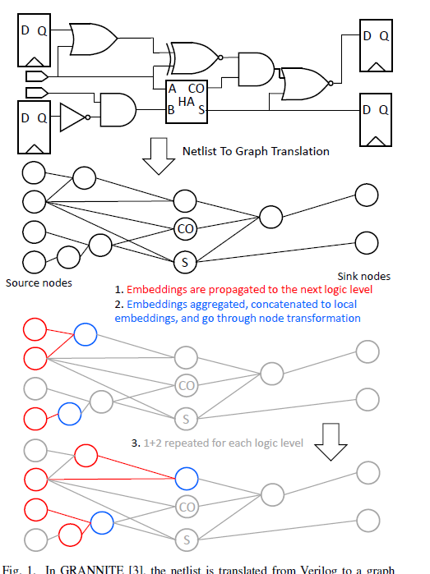
Switching Activity Prediction
To combat logic reconvergence issue, the combinational gate’s input pin and the boolean functions are seen as a node.
The propagate module is similar to GraphSAGE, which is vital for the inductive bias to understand different pin’s unique functionality.
Average error = 5.3% for power analysis, 18.7x speed up.

Slide 17
Switching Activity Prediction
The amount and frequency of switching activity is valuable for power analysis, power and timing aware physical analysis, IR-drop analysis, and signal integrity timing.
Gate-level simulation is considered the most accurate way to get switching activity.
GRANNITE is a supervised learning-based switching activity estimator (SAE).
Many aspect of the design correlates well with the actual switching.
Notes:
the industry standard SAIF (Switching Activity Interchange Format) file is used to store switching activity information.
where vector-based stimuli return exact switching counts that correspond to the input. However, gate-level simulations are very slow, typically ranging from 1-1000 cycles/s.
GRANNITE使用了DAG-GNN model architecture
since many aspects of the model’s design correlates well how switching patterns are actually determined and propagated in ground truth(基準真相).

Slide 18
Layout Symmetry Prediction
For custom circuits, various geometrical constraints is applied for better post-layout performance.
Traditionally, sensitivity analysis is the way to find matching pairs. But it is inefficient.
GNN-based method:
Inductive bias: circuit objects need matching consist of related circuit sub-structure and neighboring local
connections.
Notes:
為了解決一些類比電路的device matching, 有一些module pairs會需要針對相同的軸去做對稱的擺放。
Given different constraints, place-and-route (P&R) algorithms can generate significantly diverse final layout solutions.
they suffer from extensive simulations, thus inefficient.
電路物件(device、building block)需要匹配包括相關電路子結構和鄰近的本地連接

Slide 19
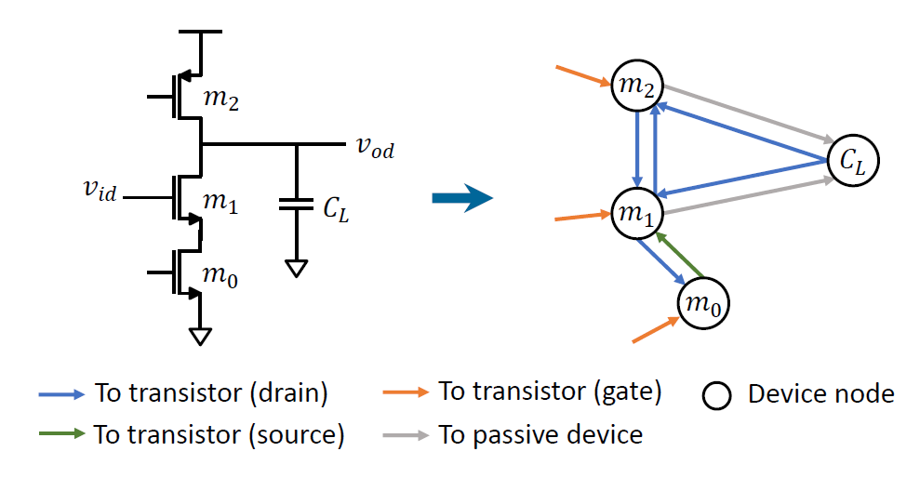
Layout Symmetry Prediction
The circuit is modeled as heterogeneous graphs.
Perform unsupervised learning on the graph.
15.8% F1-score improvement on system level constraint and 218x speed up.
9.8% F1-score improvement with subsecond runtime for device level constraint extraction.
Notes:
為了解決很大數量的未label的電路且想要使得此GNN model可泛化

Slide 20
Static Time Prediction
Fast and accurate timing prediction is essential for timing-driven placement since the accurate timing information is only available after routing.
Methods available
1. Wire load model
2. Differentiable wire delay model
3. Random forest tree model
4. end-to-end timing prediction model
5. local net delay/slew prediction model
Notes:
Thus a timing prediction model that could both effectively predict the routing behavior and replace the static timing analysis (STA) engine, would greatly reduce the runtime overhead, and further enable timing driven optimization early during placement.
Wire load model: 利用近似的方法來考慮繞線所產生的寄生效應
Differentiable wire delay model: 利用 pin的connection 來產生 rectilinear steiner tree，以此做為快速的預測routing result
Random forest tree model: 從placement result來萃取net feature，以此來預測local net delay & slew(信號轉換時間)
Slew: 是指電壓從10%VDD上升到90%VDD所需要的時間，或者是從90%VDD下降到10%VDD所需要的時間，當然也可以是20%VDD上升到80%VDD的時間，具體要看timing lib庫裡面的定義
local net delay/skew prediction model: 利用GNN來取代人力尋找features，並且使用DAG-GNN的架構來取代STA

Slide 21
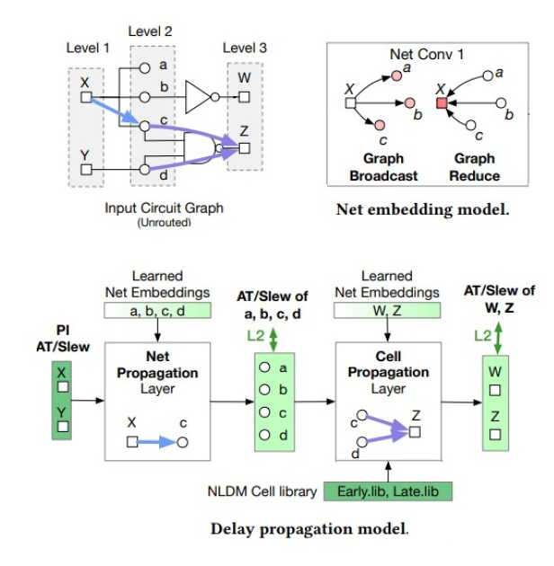
Static Time Prediction
Consist of two parts:
1. Net embedding model
2. Delay propagation model
The circuit is represented as heterogeneous graphs:
1. logic gate pin -> node (PI & PO are different type)
2. net edge(PO with PI), cell edge(PI with PO)
Notes:
analogous to modern STA engines that splits the timing analysis into two steps :
1. where local net delay and loads are calculated
2. arrival time and slack are propagated on the timing graph
這個graph就會因此與當今STA tool 的timing graph很類似，並且使inductive bias很有效率
Net embedding model: GNN會在產生的DAG上運作。他會將logic gate pins轉為node embeddings，這樣就可以很容易的將neighbor circuit level information提供給每一個pins.
Delay propagation model: 使用DAG-GNN model.

Slide 22
Static Time Prediction
The net embedding model is improved compares with the feature-based random forest model
The DAG-GNN effectively leverages the problem structure and inductive graph bias on timing
graphs.
Notes:
他可以有效的萃取出有用的circuit features來預測local net delay。 這些labeled features與最終做出來的global timing metrics有很強的關聯性，R平方score大約為0.8957

Slide 23
04
GNN for Design Optimization

Slide 24
Placement
Type: macro placement, cell placement, transistor placement, etc…
Inductive bias: similar circuit should have similar placement.
The paper mentions the placement at macro and transistor level:
1. Adopt Reinforcement learning as optimization framework to optimize placement.
2. Use GNN as feature extractor to learn information for the circuit graph.
Notes:
Force directed placement algorithm:
cell->vertices,
net->edge,
objective: minimize the Euclidean distance between two cells , meanwhile keep the state of equilibrium.
所以給定相同的電路架構以及I/O bound的位置，state of the equilibrium應該也要一樣。

Slide 25
Placement: Macro placement
Cast as Markov Decision Process(MDP).
Edge-CNN network:
1. Cell cluster or macro need to be placed -> node.
2. Propagation module: combine the node features and edge features.
Notes:
MDP: 一次只按照順序的place一個Macro。他會建一個Edge-GNN network，並且這個network會從現有的placement result學習，他的output就可以feed到CNN network來產生RL policy，那這個RL policy就可以給下一次的placement使用。
Node feature: macro的width、height、x、y
Edge feature: weight->根據時間的重要性產生weight。
Generate net embeddings and update node embeddings

Slide 26
Placement: Transistor placement
NVCell
Cast as Markov Decision Process(MDP).
Notes:
NVCell: nvidia所開發，這套工具可以根據標準的處理單元佈局來自動產生晶片的設計圖，也可以用來檢驗人類員工設計出來的晶片佈局中有無錯誤。
MDP: 一次只從左到右擺一個裝置(device: NMOS, PMOS, I/O pin)
這次placement的狀態會被表示為一張graph, 然後會利用GNN來計算它的node embeddings. 接著這些node embeddings會被用來計算RL placement policy, 而RL placement policy會被用來計算下一次device的placement位置。

Slide 27
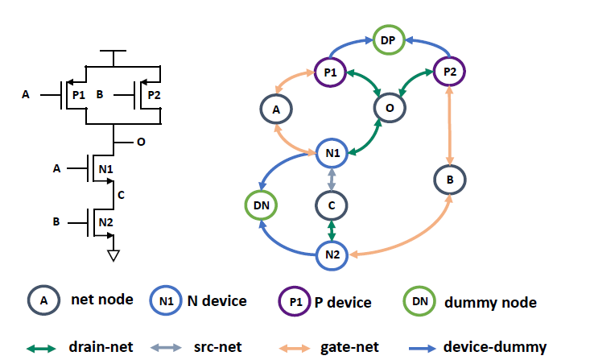
Placement: Transistor placement
Placement feature:
{0} : the device is not placed yet
{1} : the device is placed previously
{2} : the device is placed now
Inductive bias of the placement feature design:
The device placed subsequently have high correlation to each other
Propagation module of this GNN:
Continuous kernel-based convolutional operator
Notes:
我們可以發現圖中有四種device node: net 、pmos transistor、nmos transistor、dummy transistor，那其實還有一種是I/O pin.
Dummy transistor 的出現是因為相鄰的電晶體不能共享diffusion，所以會需要dummy transistor的存在。那我們也可以發現在dummy transistor以及其他的transistor之間也會有一個edge，那它其實是一個虛擬的edge，目的只是為了要讓GNN可以知道甚麼時候要插入dummy transistor。 我們也可以發現不同的node之間的edge種類也會不相同。
Propagation module : 他會使用不同的edge的權重來合併不同neighboring node的node embeddings。 這種propagation module可以區分不同的subgraph pattern.

Slide 28
Placement: Transistor placement
The inductive bias of placement can also be treated as the constraint of the model.
The Edge-CNN edge embeddings can be used to predict the total wirelength of the final placement.
The wirelength can be treated as the value function for the PPO RL algorithm.
Notes:
Edge embeddings 可以看做每一個edge的edge predictor,並且total wirelength可以由所有edge的預測值的平均來決定。

Slide 29
05
Challenge

Slide 30
GNN Challenges
Some are common for machine learning
Graph isomorphism: Weisfeiler-Lehman isomorphism test、Graph Isomorphism Network (GIN)
Time consuming
Notes:
1. feature的選擇、dataset的準備、模型架構調整…
2.我們希望學到的 GNN 具備的其中一個性質，是讓結構不同的圖，輸出不同的 Representation，才不會讓它把兩張不同的圖當成同一張搞混。 但是要判斷一張圖是否同構，是一個很難的問題。
有一片論文提到它證明了了所有的 GNN 模型，在 Graph Isomorphism 上，最多最多只能做到 WL-Test 的程度。所以跟 WL-Test 同等厲害的模型都好棒棒，比 WL-Test 差的，至少在 Graph Isomorphism 問題上就不太行。
3. 在sequential 的信息傳遞中，會很花費時間。但是現在已經有很多加速器，像是Deep Graph library(DGL)跟Pytorch Geometric，都可以很大程度的降低運作時間。

Slide 31
06
Conclusion

Slide 32
More about GNN
Graph self-supervised learning (SSL)
1. Generation-based method
2. Auxiliary property-based method
3. Contrast-based method
4. Hybrid method
Think more about the inductive bias will achieve better solution of the problem.
Notes:
Graph supervised learning : 1. 沒有足夠的labeled data 2. 因為過擬合導致generlization的能力變差
SSL會使用dataset本身的loss funciton/supervision signals，進而降低對手動標註的依賴，提供更好的表示的學習方式。
1. 生成式的方法: 他會重構輸入的數據，並且將輸入數據做為supervised的信號。重構可以大致分為特徵重構以及結構重構
2. 輔助式的方法: 他會在training loss中加入額外的特性以及topological graph，以此來有效地為數據加入新的標籤。
3. 對比的方法: 強化相同圖的相似度，並且降低不同圖的相似程度
4. 混合的方法: 結合以上3種方法

Slide 33
THANK YOU FOR LISTENING!

